Slide 1
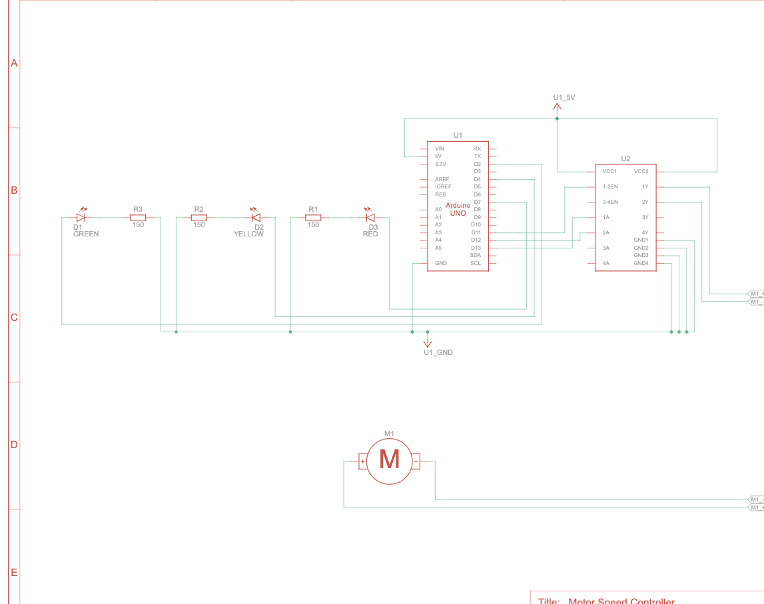
Motor Speed Indicator Construction Guide
By: Nathan Fikes ME 3024 UTA

Slide 2
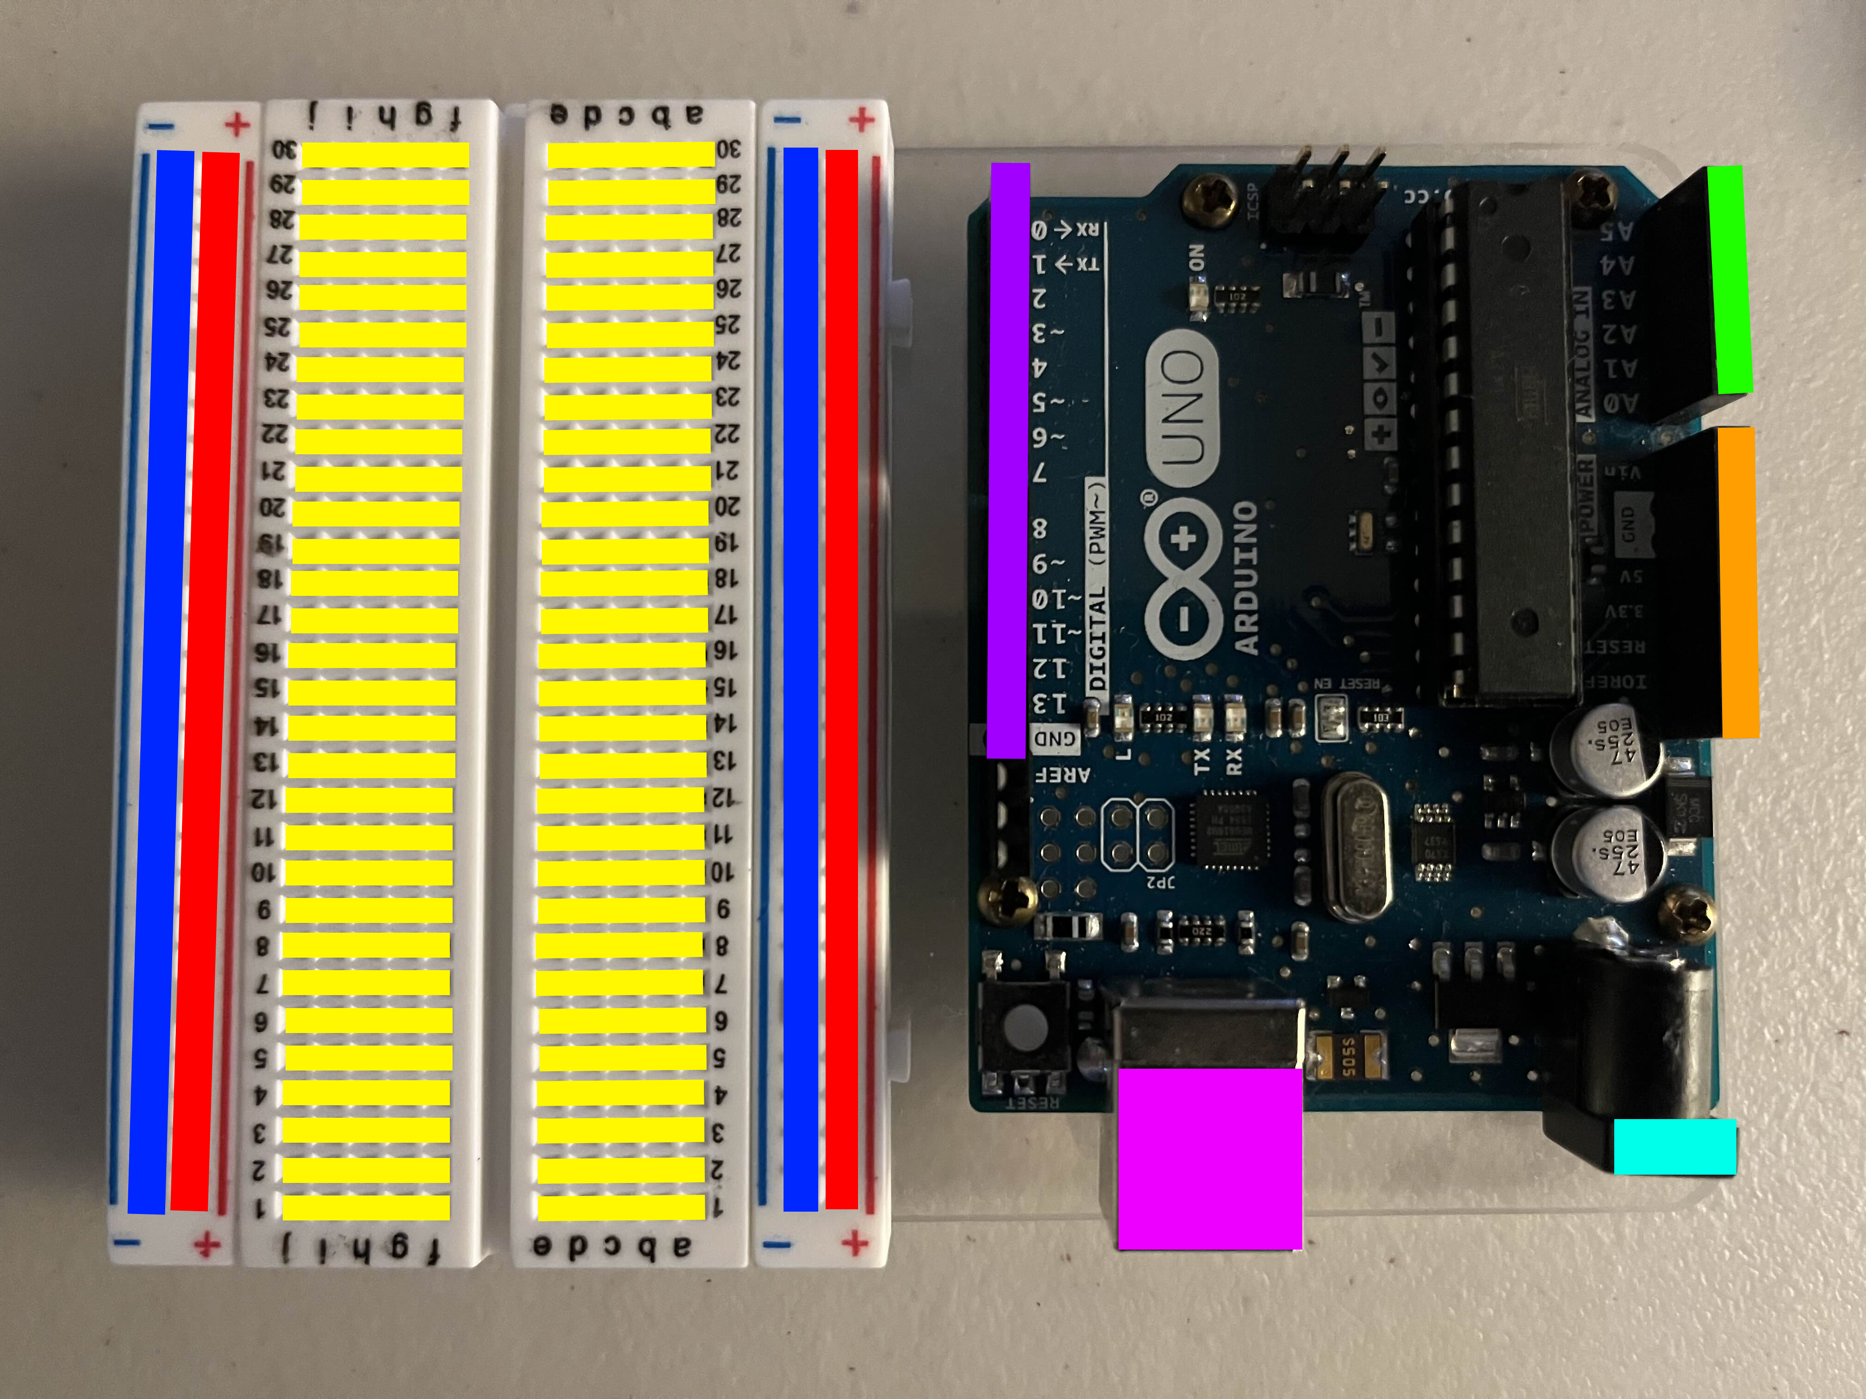
Step 1: Familiarize yourself with the sections
1
Blue – Power Rail reserved for low-potential. (Line indicates a line of metal)
Red – Power Rail reserved for high-potential. (Line indicates a line of metal)
Yellow – Electrical Nodes. (Each line is a node, a line of metal)
Purple – Pins reserved for Digital outputs and inputs. (Each pin is separate)
Green – Pins reserved for Analog inputs.
(Each pin is separate.
Orange – Pins used for supplying power and ground. (Each pin is separate)
Light Blue – Board Power.
Pink – USB Serial Connection Point.
3
2
4
1
5
2
6
3
4
5
8
7
6
7
8

Slide 3
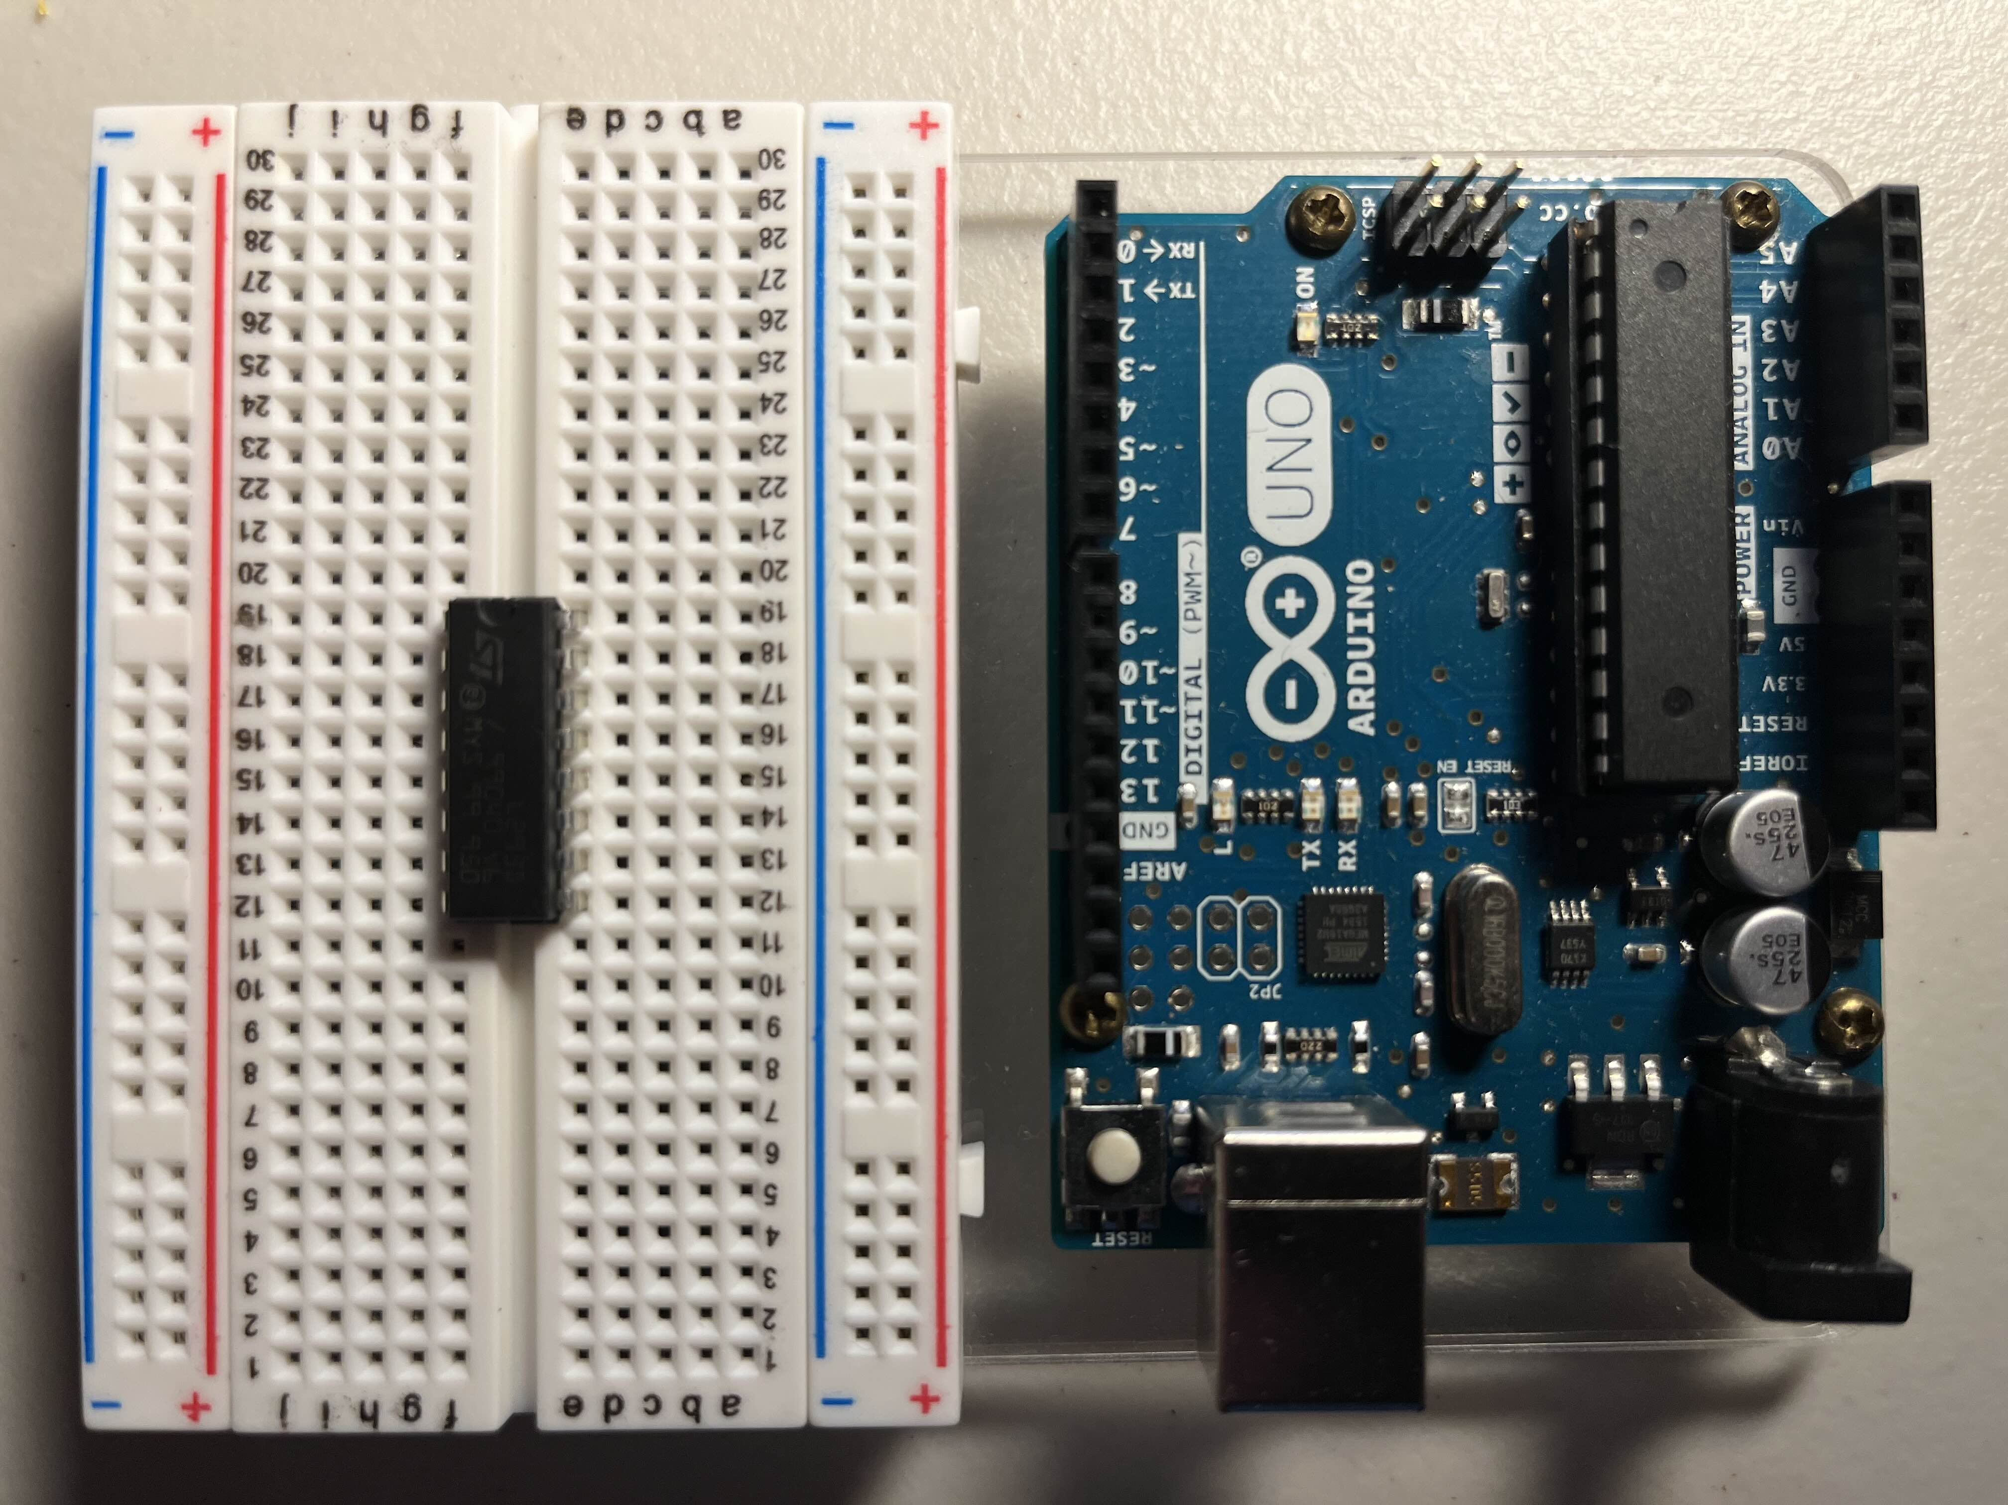
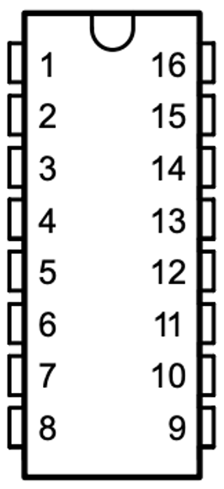
Step 2: Insert H-Bridge chip
Insert the H-Bridge chip labeled L293D in the upper right of the chip.
Orient it such that the round notch in the top of the surface points in the direction shown on the left.
Pin 1 starts from the upper left and goes counterclockwise to pin 16.
You may need to squeeze the pins in a bit for it to fit across.

Slide 4
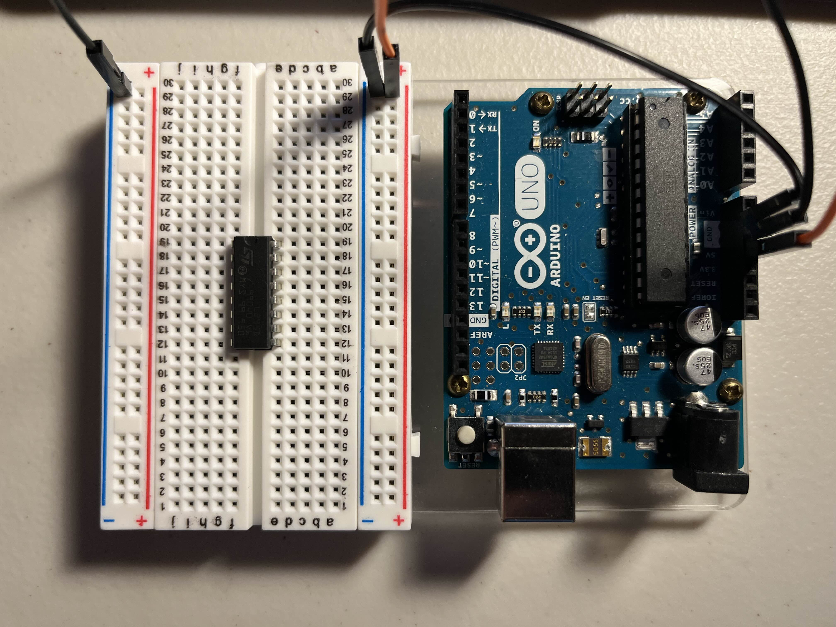
Step 3: Ground and Power
2
1
Connect the TWO GND ports from the UNO to both BLUE rails on the breadboard. (These are now Ground)
Connect the 5V pin on the UNO to the RIGHT RED rail on the breadboard. (This is now a 5V power rail)
1
1
3
2
2
3
3

Slide 5
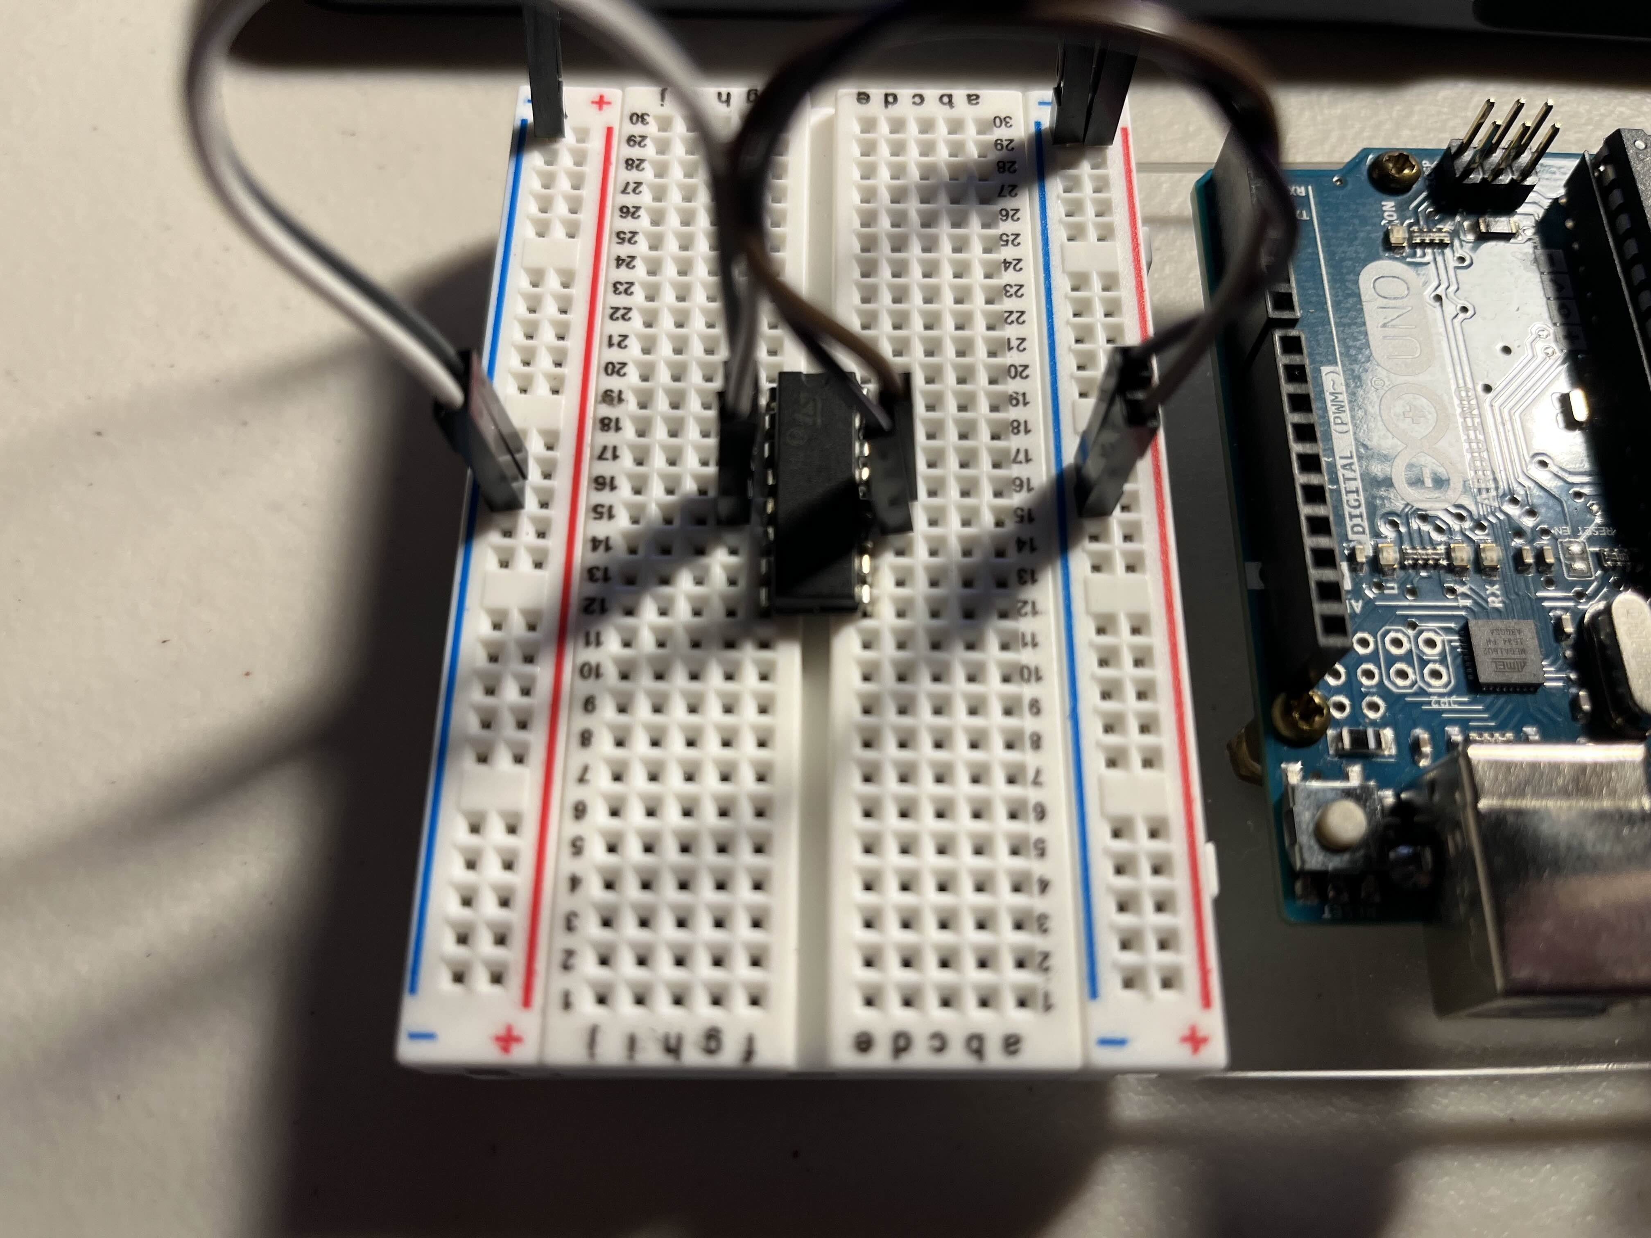
Step 4: H-Bridge Sink
1
Connect H-Bridge pins 4,5,13, and 12 to the BLUE ground rails.
The reason these four pins need to be connected to the ground is because the chip needs a high current path to dissipate energy. H-Bridge chips can direct high voltage. (Modern devices dissipate energy as heat through fins or ground planes, the H-Bridge just dumps the energy back onto GND
2
1
2
1
2

Slide 6
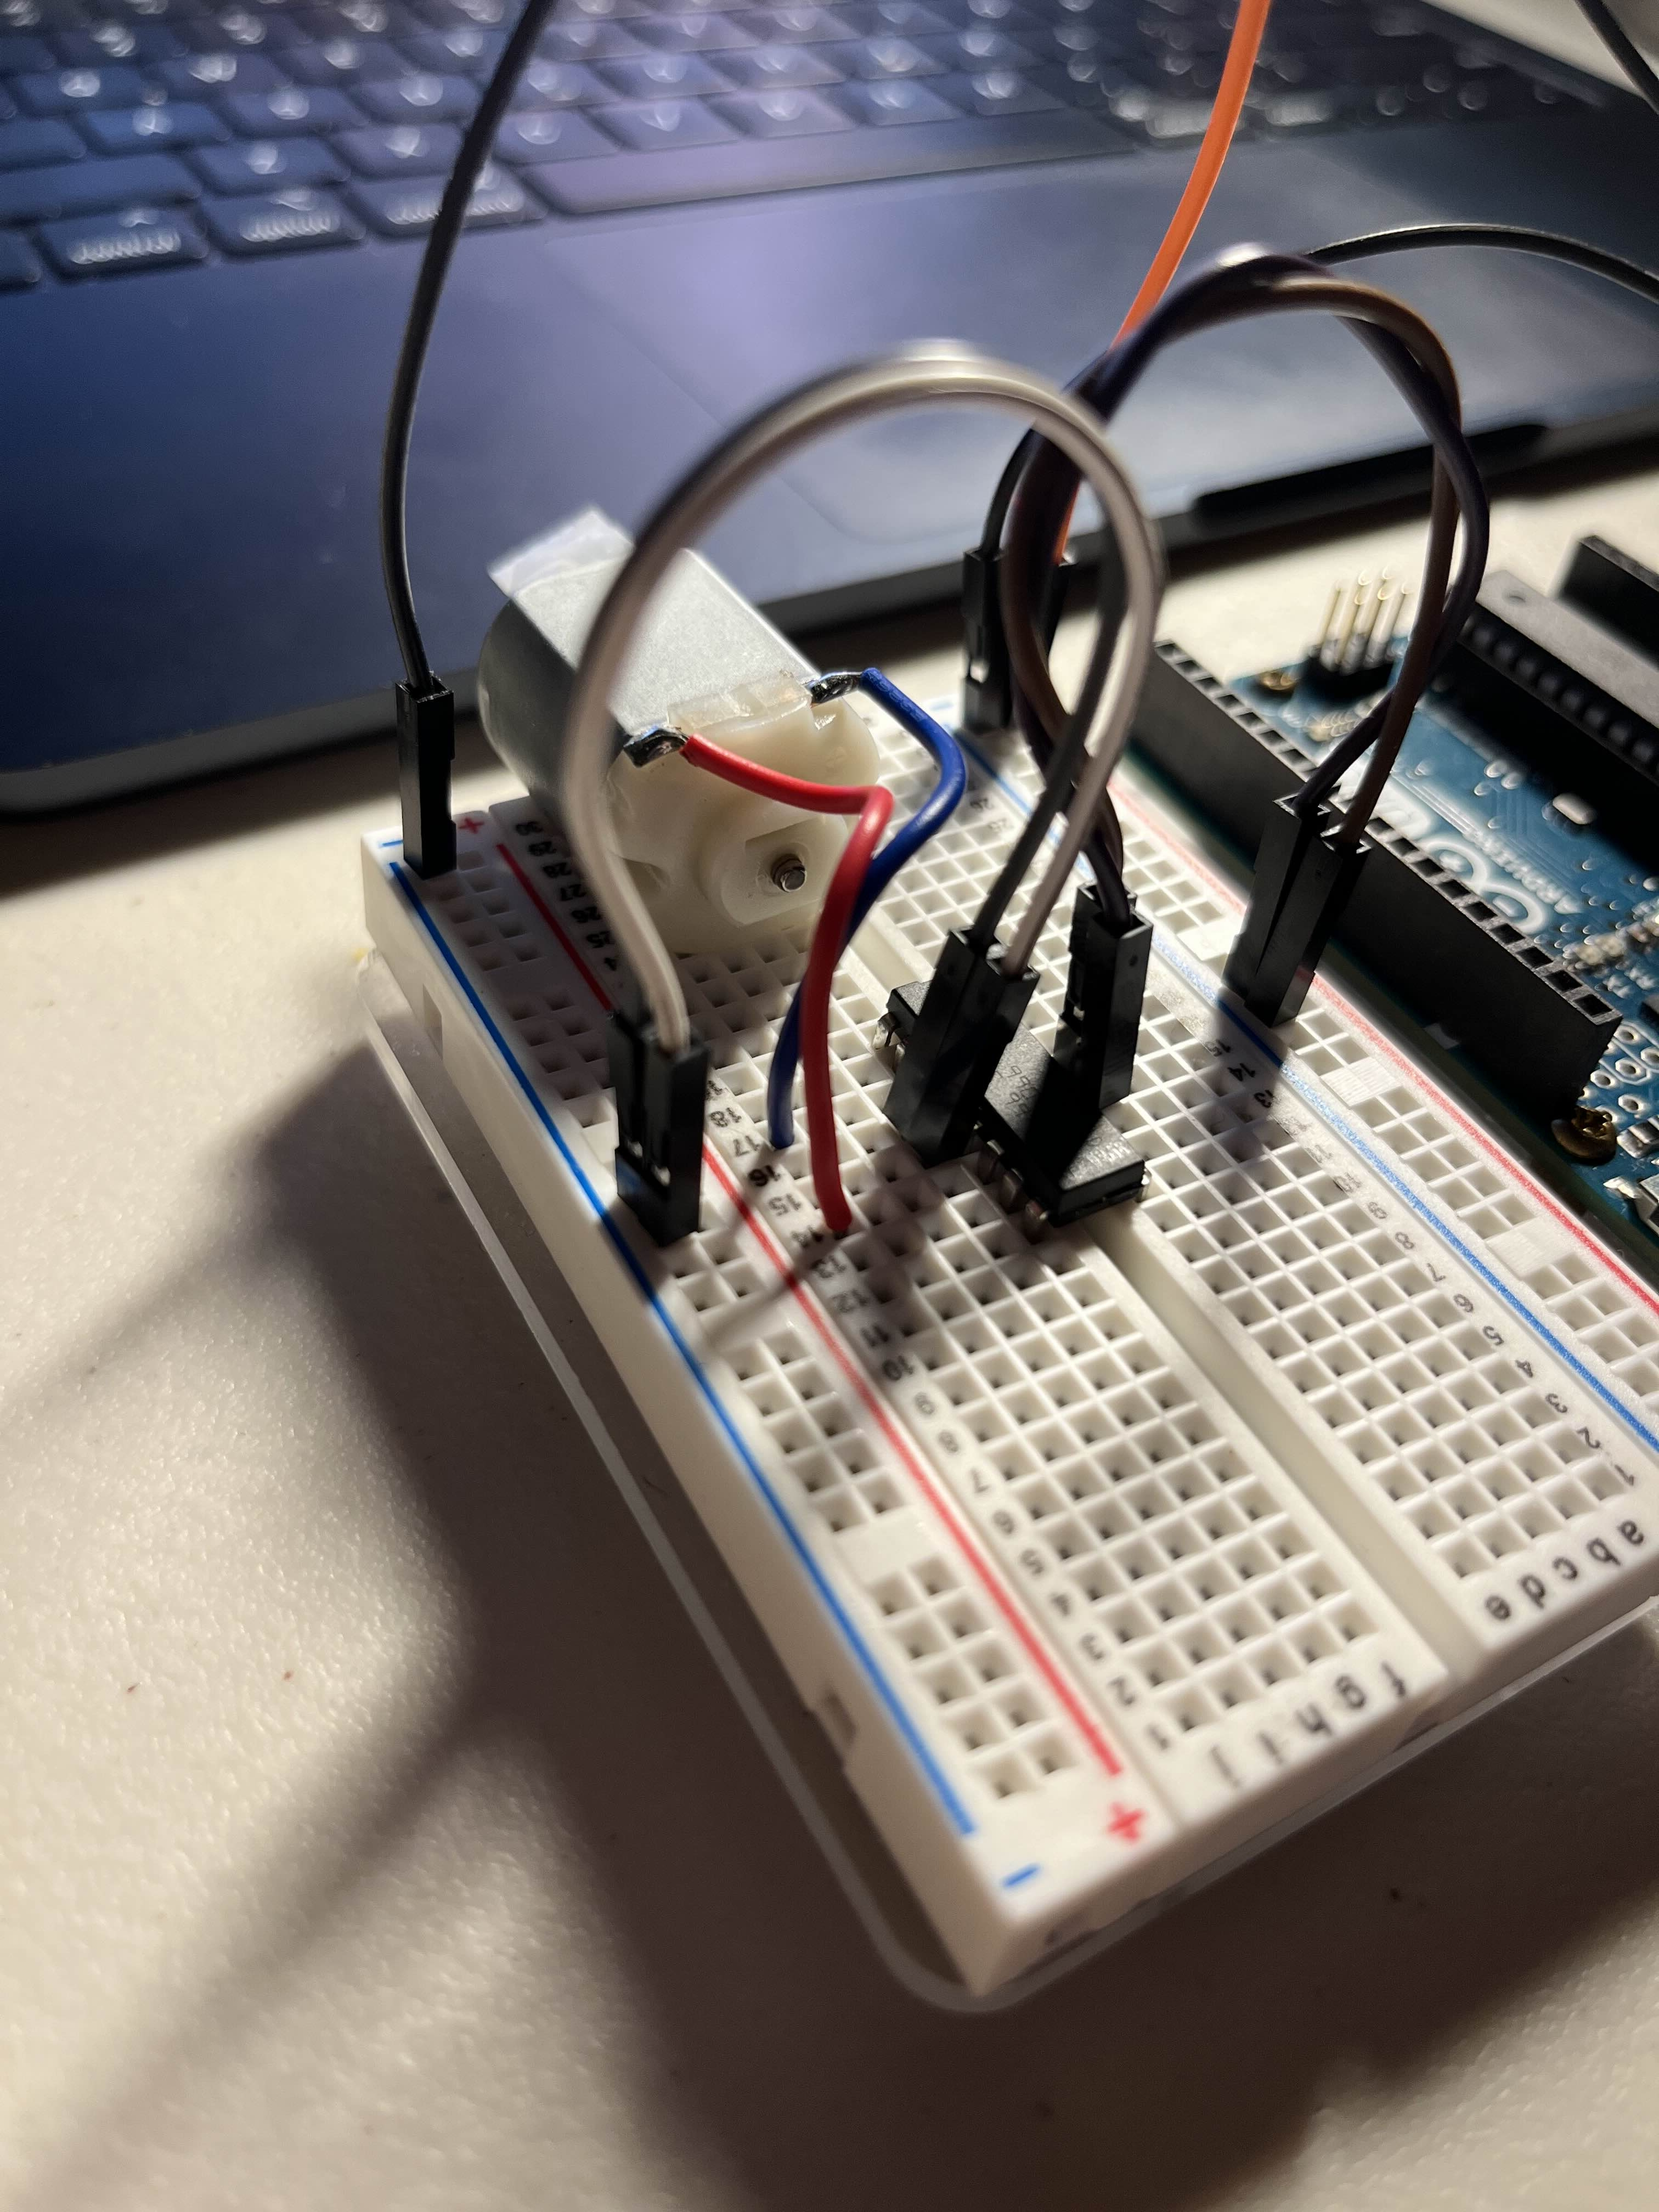
Step 5: Connect motor
Connect motor leads (Polarity does not matter, meaning blue and red can be connected either way) to pins 3 and 6 on the H-Bridge.
You can also place a folded piece of tape on the motor shaft if you would like to see which way and how fast the motor is spinning.
1
1
2
2

Slide 7
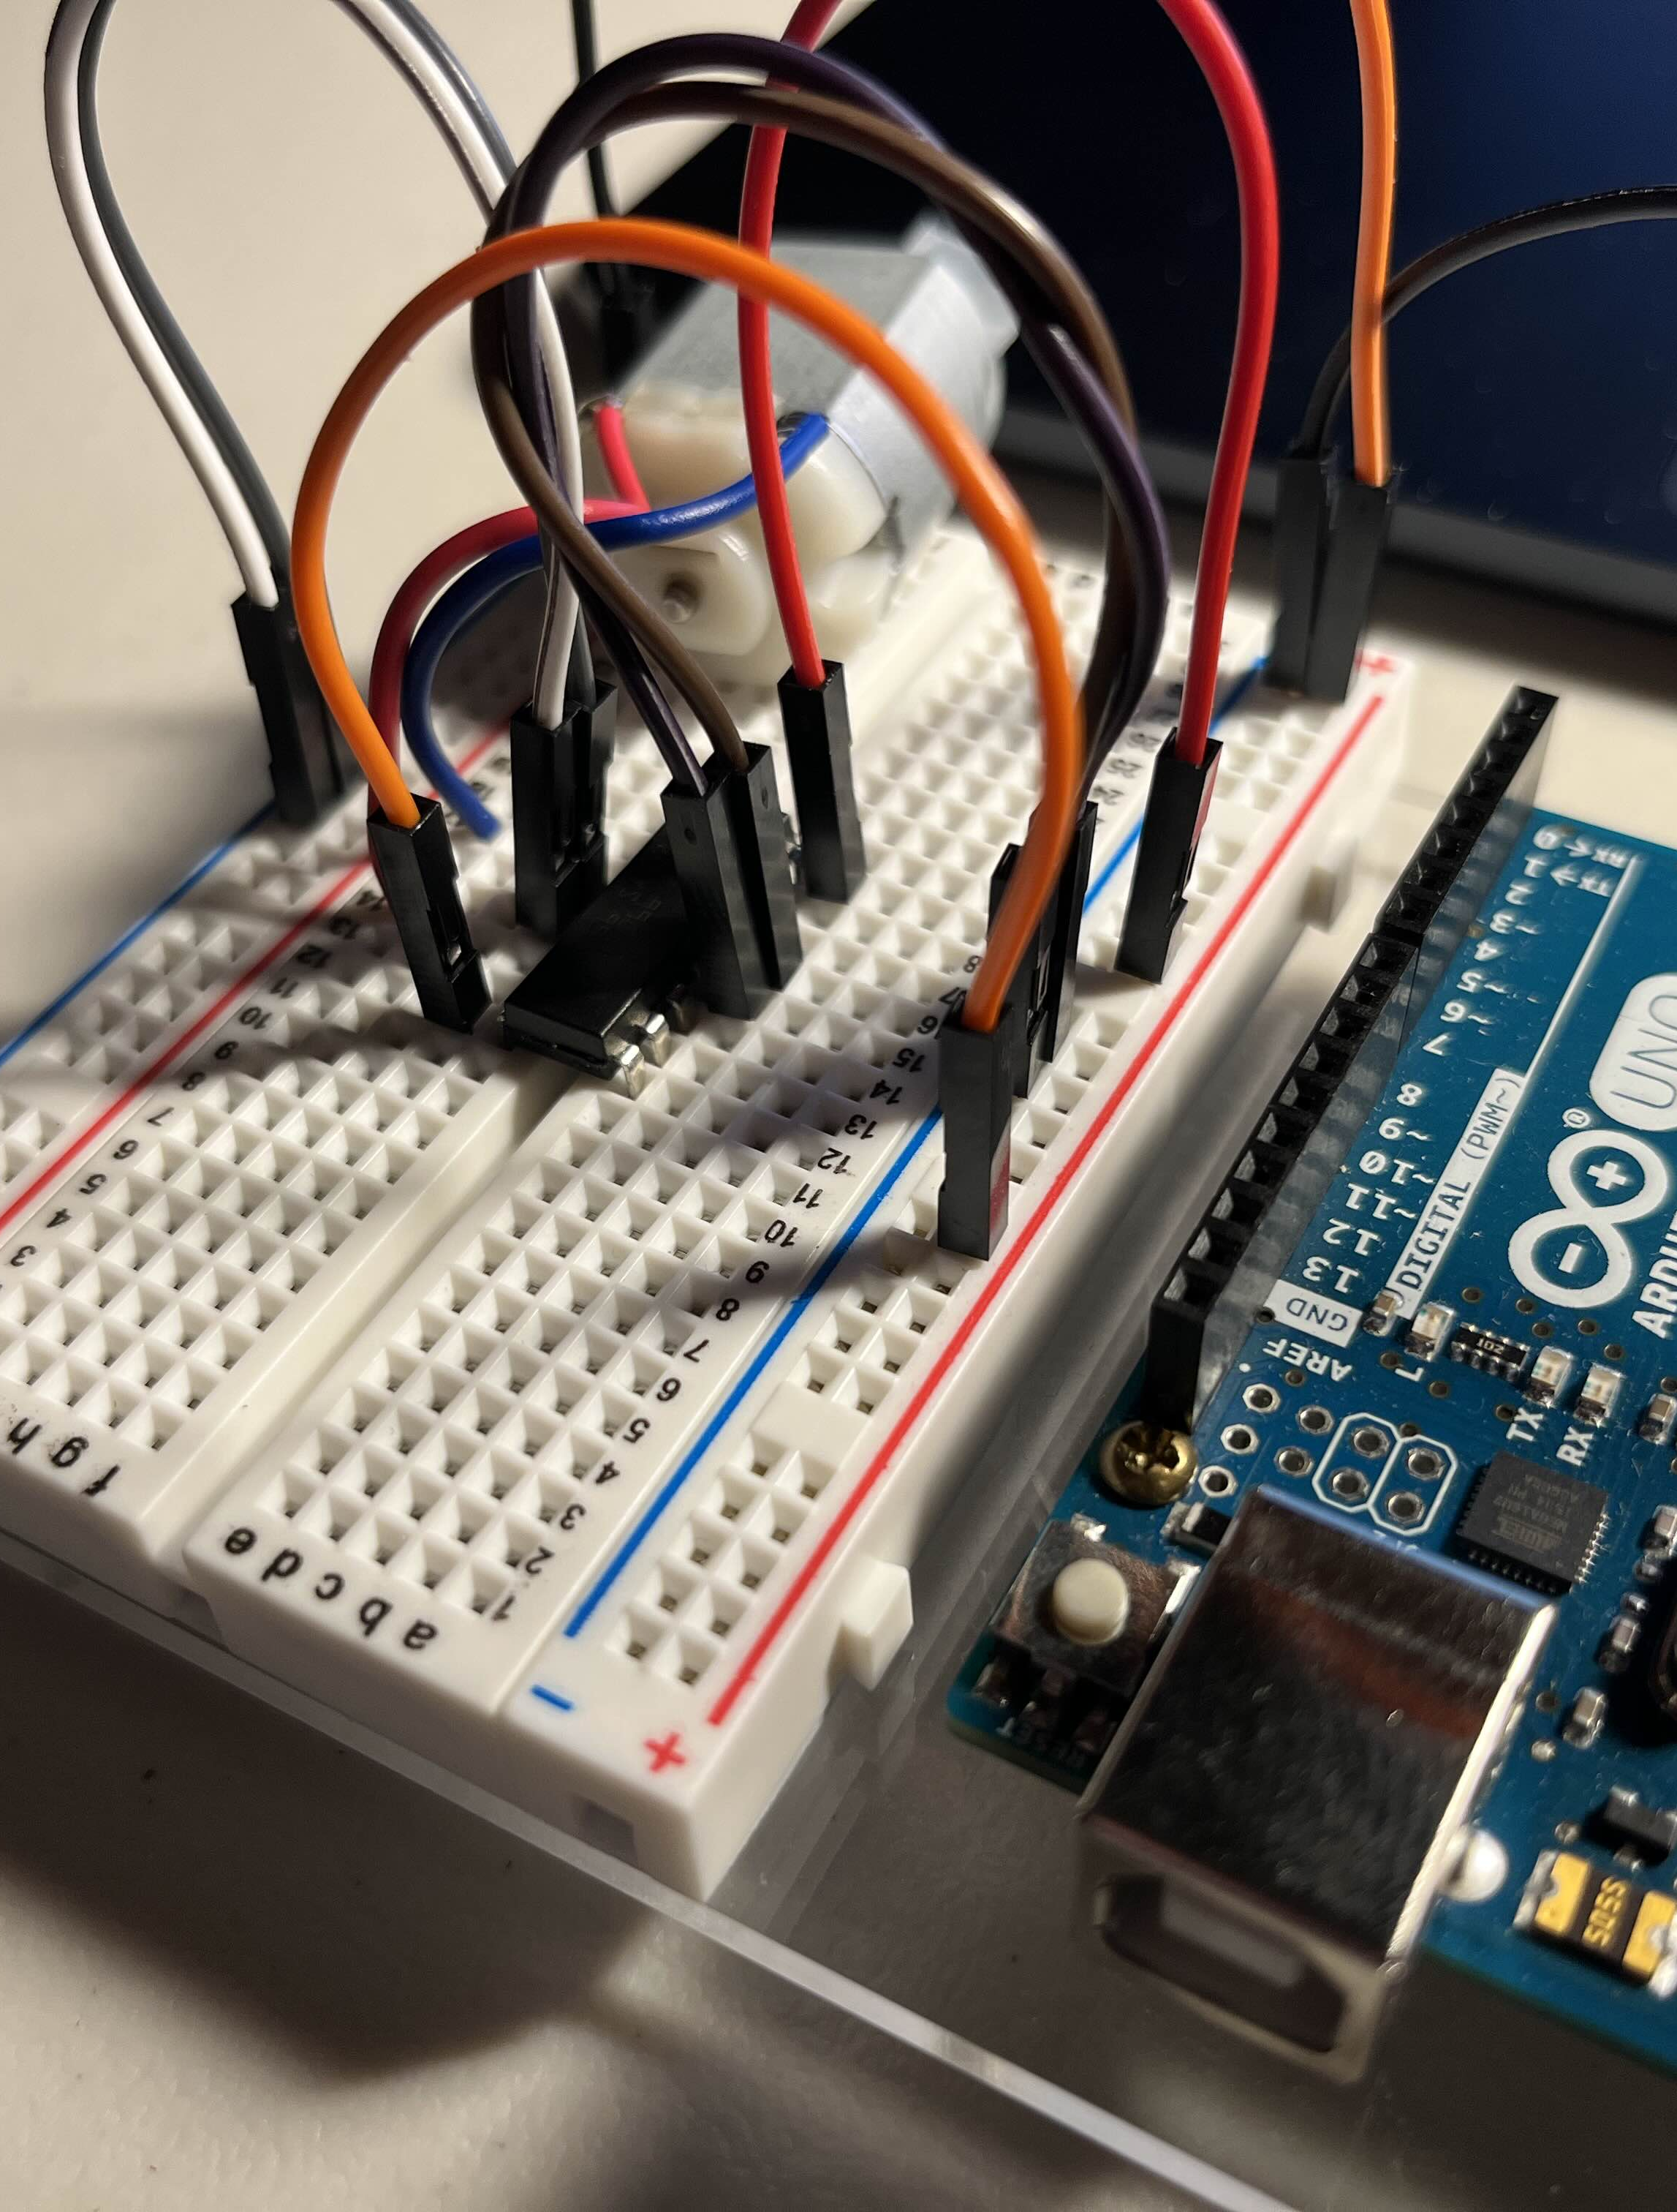
Step 6: Driver VCC and Component Power
2
Connect pin 16 to the RED 5V power rail. This supplies a voltage for internal logic translation.
Connect pin 8 to the RED 5V power rail. This is your high-power motor line. For the demonstration we will load the motor under 5V. ALWAYS check motor and H-Bridge specifications before increasing the power of this pin. (The pin be supplied by a 36V potential relative to GND)
2
1
2
1
1

Slide 8
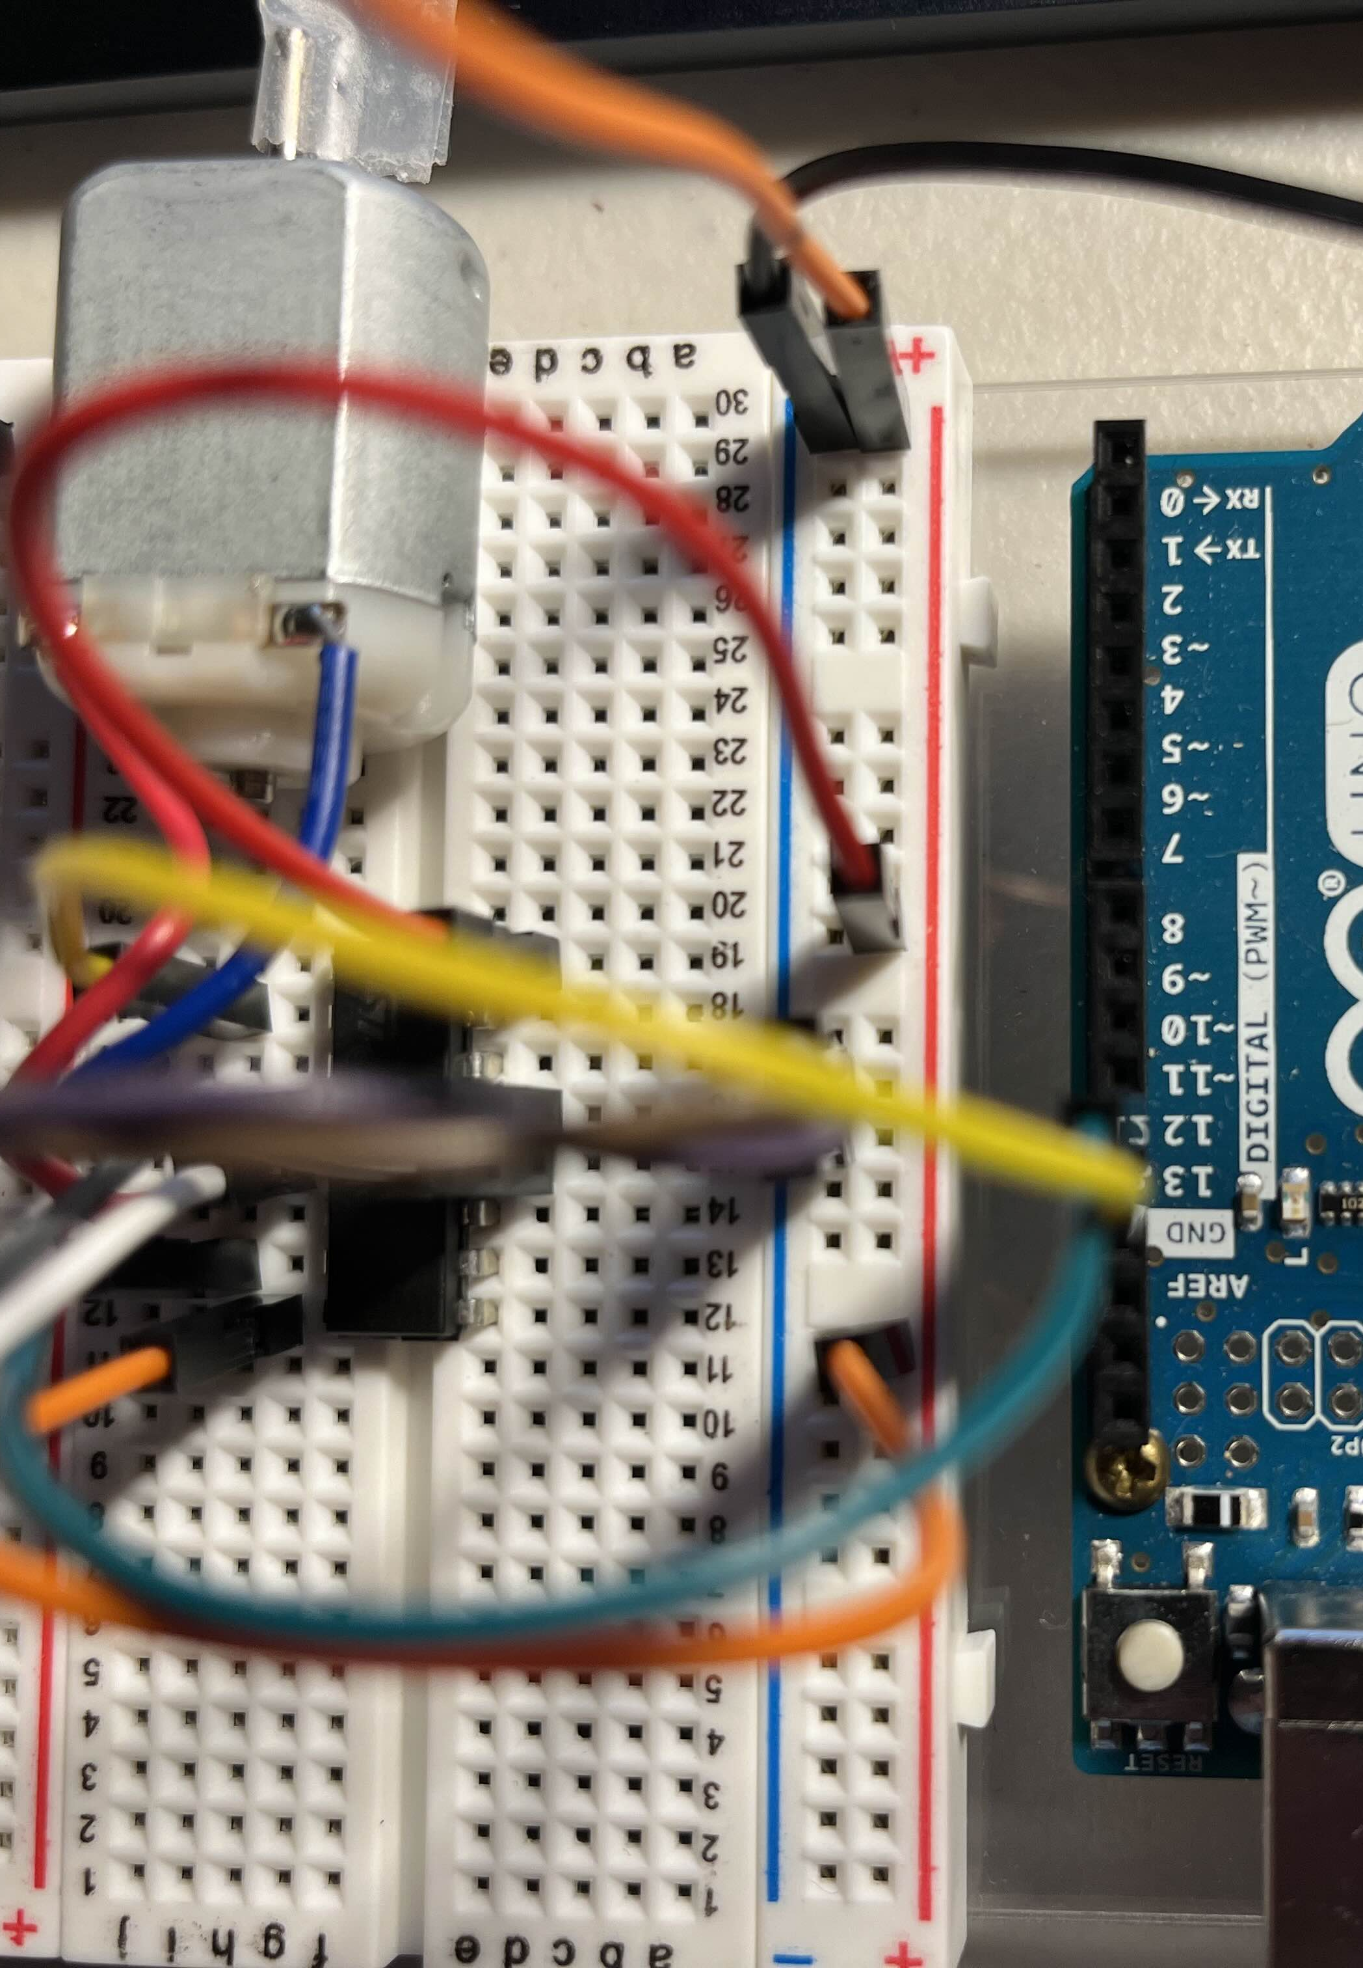
Step 7: Logic Table Actuator Pins
Connect pins 2 and 7 of the H-Bridge to pins 13 and 12 of the UNO.
Bridge 2 -> 13 UNO (Yellow Wire)
Bridge 7 -> 12 UNO (Green Wire)
These pins actuate the H-Bridge according to the logic table to enable direction switching.
1
1
2
2

Slide 9
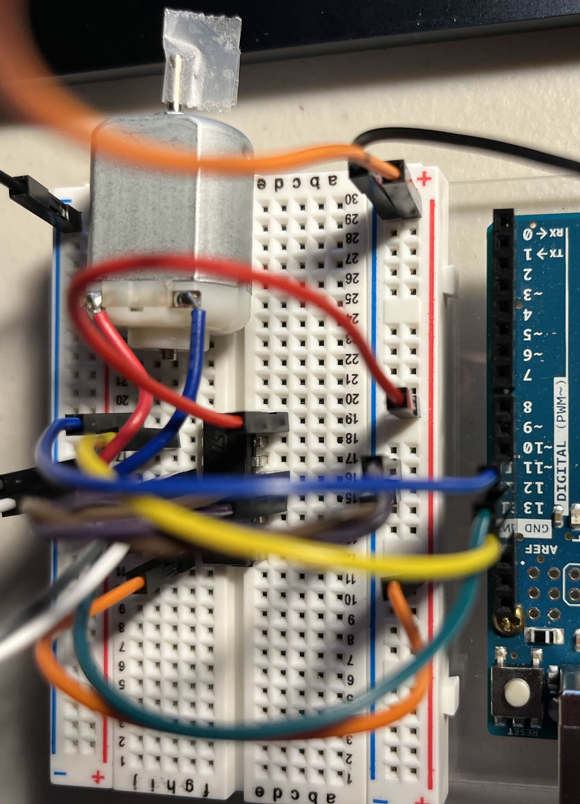
Step 8: PWM for Enable Pin
Connect pin 1 of the H-Bridge to pin ~11 of the UNO. (Blue Wire)
PWM enables and disables the Enable Pin to actuate the Logic Table once again, however, when the PWM is low the motor coasts while high it drives. This causes a speed change based on Duty Cycle.
1
1

Slide 10
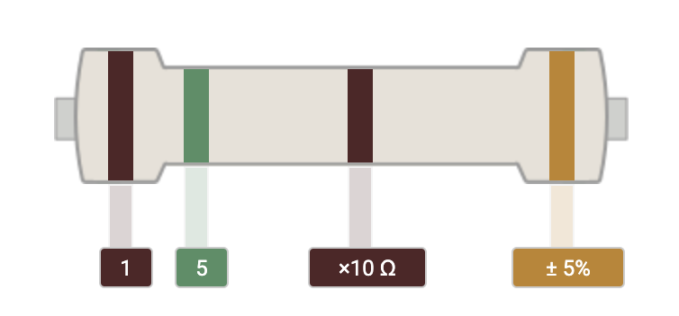
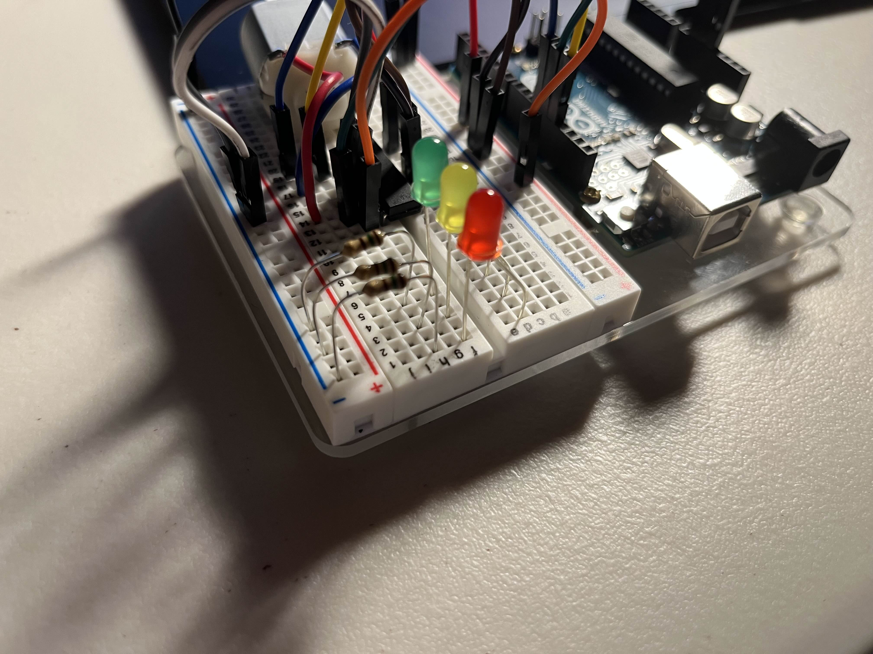

Step 9: Resistors and LEDs
Connect 3, 150[Ω] resistors to the GND rail with their other ends each on a separate node.
Connect the SHORT end of the LED to the left node and the LONG end to the OTHER node on the right.
Points 1 2 and 3 should be separate from each other.
3
2
1

Slide 11
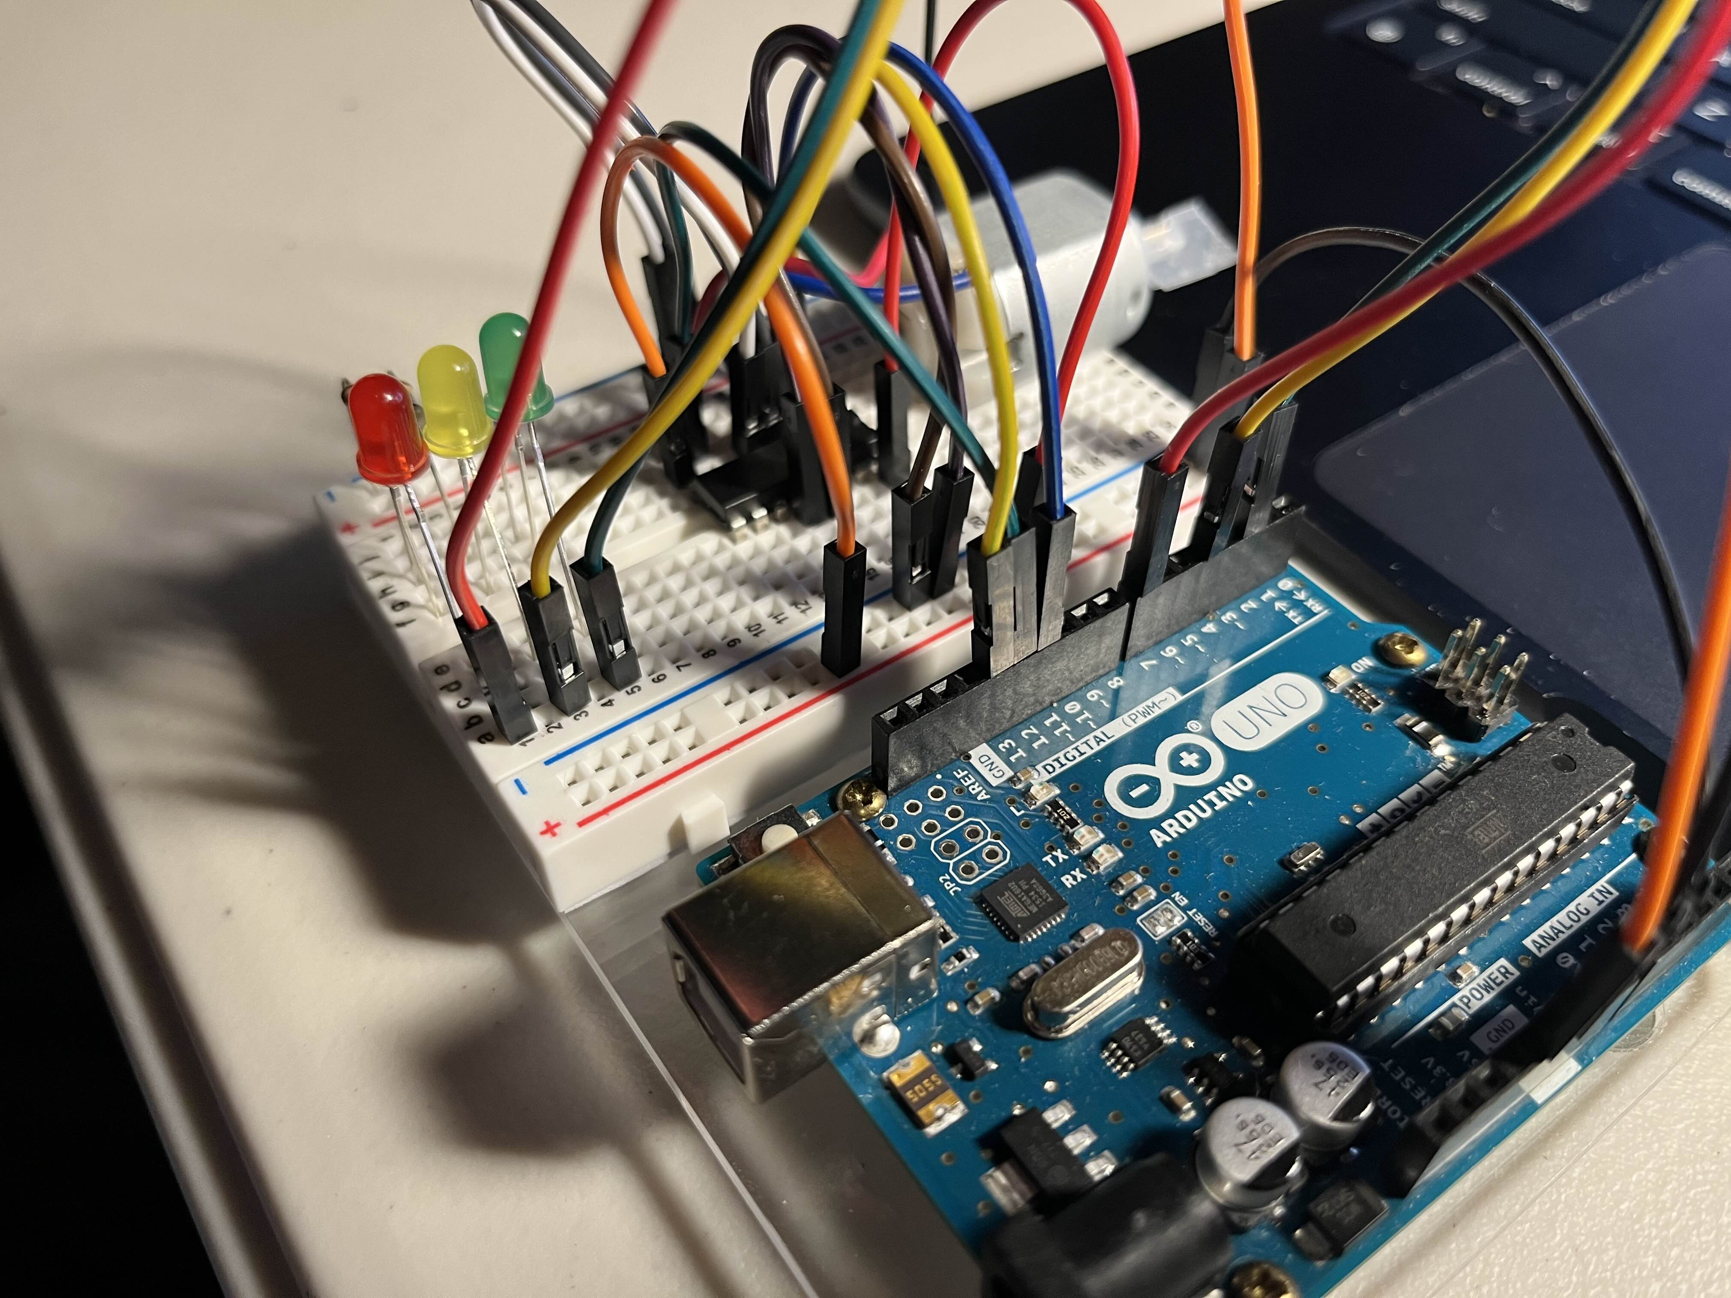
Step 10: Connect LEDs to UNO
1
Connect the RED LED long lead to pin 7 on the UNO.
Connect the YELLOW LED long lead to pin 4 on the UNO.
Connect the GREEN LED long lead to pin 2 on the UNO.
2
1
3
2
3

Slide 12
Programming
Download and Install Arduino IDE from this link: https://support.arduino.cc/hc/en-us/articles/360019833020-Download-and-install-Arduino-IDE
Follow the instructions for your OS on the website.
Once installed open Arduino IDE.

Slide 13
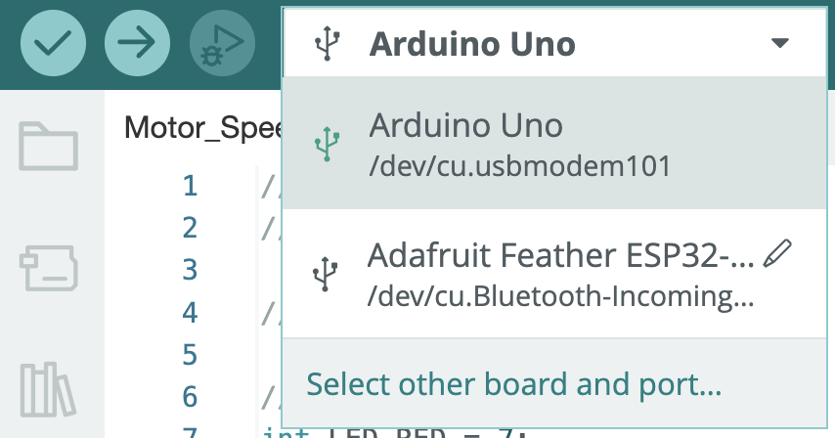
Steps for setting up
Go to [File]->[New Sketch]
Press [CTRL or ⌘] + [S] and save the sketch under the name “Motor_Speed_Demo” The extension .ino will be applied after saving.
Plug in your board and navigate to the upper left of the screen.
Find the USB symbol and press [Select other board and port…]
A screen will pop up and a [Search board] a text field will appear.
In this field type “arduino uno” and select the [Arduino Uno] board type under the BOARDS section.

Slide 14

Continued…
Make sure your board is currently plugged in.
On the right under PORTS select the port your board is connected to. If it is the only peripheral device, the port should be [Serial Port (USB)]. If you can’t find this make sure to re-plug the UNO or unplug all other devices like BLE mice or charging phones.
Once both the BOARD and PORT are identified and selected press the [OK] button in the lower right.
Next navigate to the top right of the screen and find the [Serial Monitor] icon and press it.
On the bottom of the screen will be a tab labeled [Serial Monitor X]. This will be how you will read messages from the board. Or talk to the board if you would like.
Find the baud on the lower right and change it to [115200 baud].

Slide 15
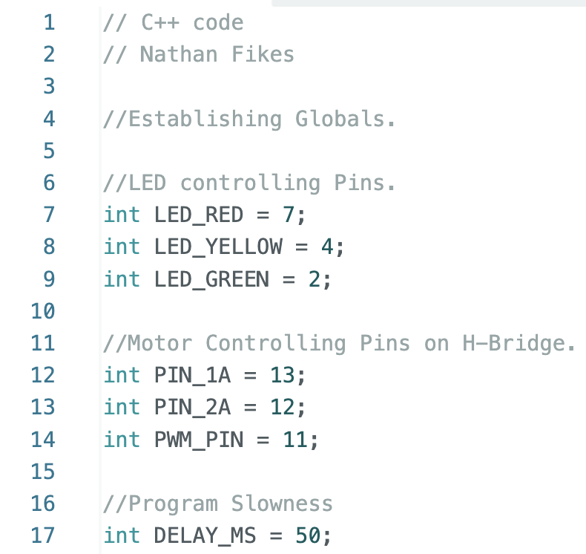
Step 1: Programming
Define the global variables on the left as shown. The first 6 are integers defining where the pin addresses are on the board.
The 7th integer will be used later in the program to pace the loops.
Pay attention to the pins here, they should match with the connected ones on the board.

Slide 16
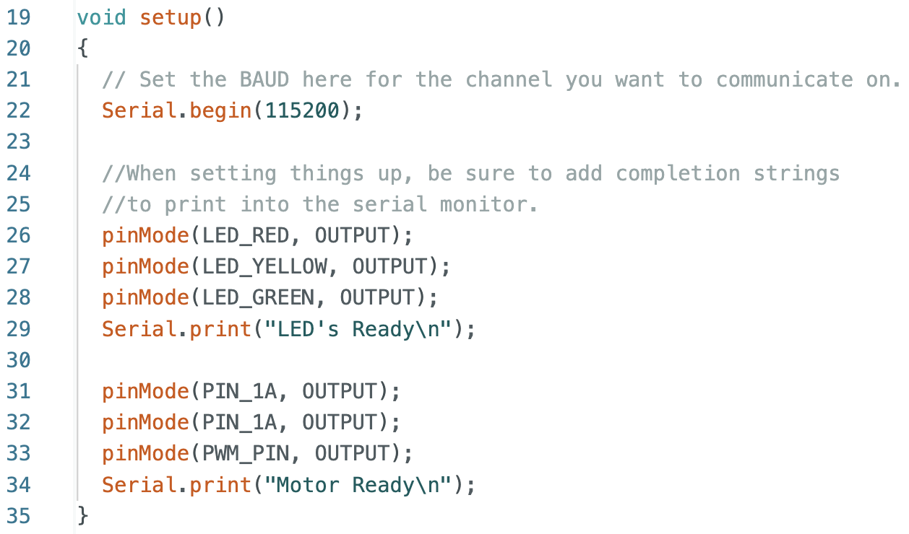
Step 2: Programming
Line 22 sets the channel with a baud rate. Remember we set the computer to communicate at 115200 baud.
Lines 26-28 and 13-33 indicate pins at these addresses are outputs and the board adjusts accordingly.
Lines 29 and 34 indicate that section of the code has been completed.
Make sure everything is inside the void setup function as this will execute a single time when booting.

Slide 17
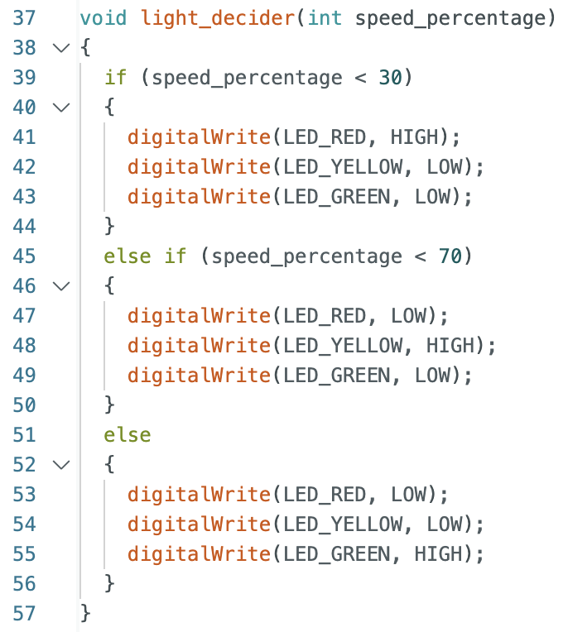
Step 3: Programming
Define a custom function here that takes in an integer called speed percentage. We will turn ON or OFF lights according to this “speed” integer.
At around 30 the motor will likely not turn, we will turn on the RED LED and turn off all the others.
The same goes for the other conditionals.

Slide 18
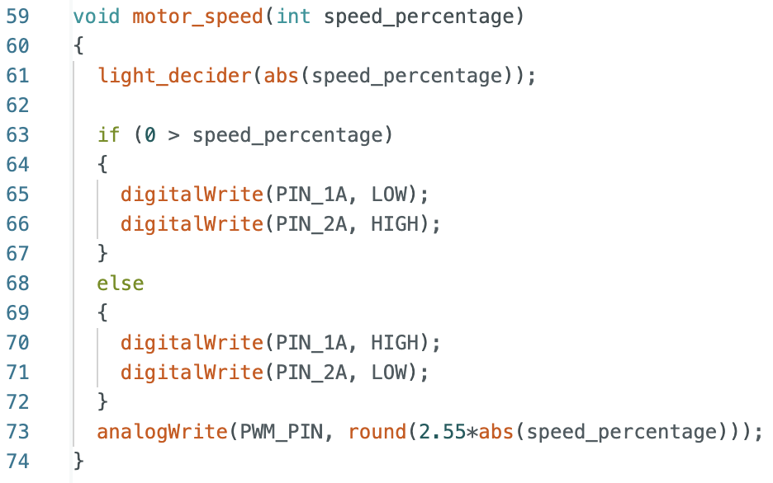
Step 4: Programming
Define another custom function called motor speed that takes a speed percentage.
In line 61 Call the light decider function with the absolute value of the speed percentage.
Set up a conditional if statement that separates the forward and backward speed indications.
In each part of the if else statement we turn on and off the two Logic Table Actuator pins to reverse the H-Bridge.
Line 73 writes the PWM duty cycle to the PWM pin for driving the Enable pin of the H-Bridge.

Slide 19
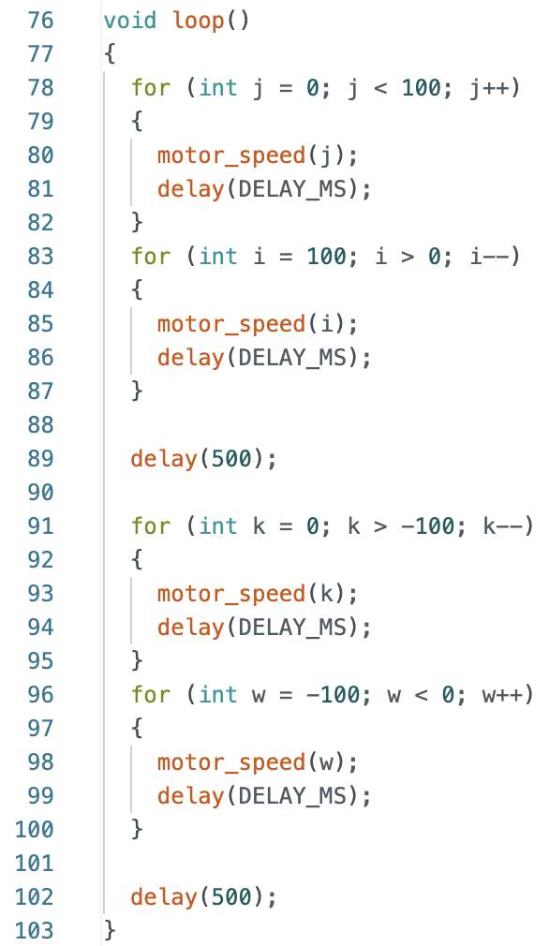
Step 5: Programming
Inside the main loop, use four, for-loops to move the motor speed from 0 to 100 and back and then 0 to -100 and back.
Insert delay functions between the two sets of for-loops to have a brief pause before moving again.
Inside each for-loop is a delay using the DELAY_MS global defined in the first step. Change the global variable at the start of the program to vary the speeds at which the motors ramp up or down.
Inside each for-loop call motor_speed with the integer speed percentage generated by each individual for-loop.

Slide 20
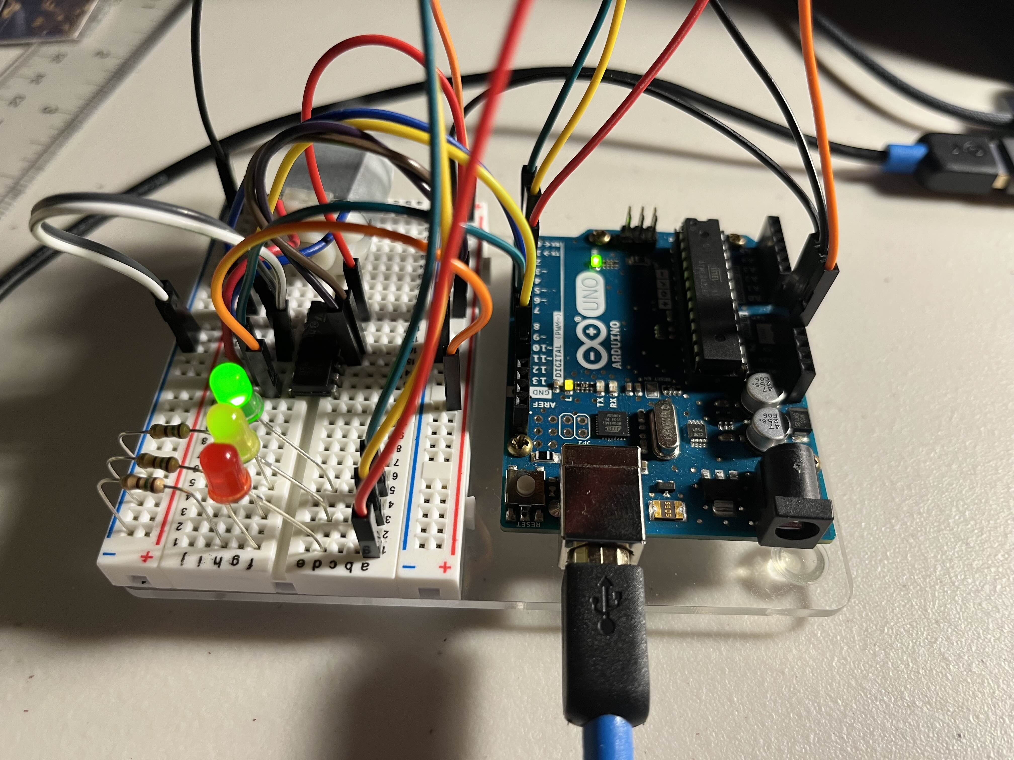
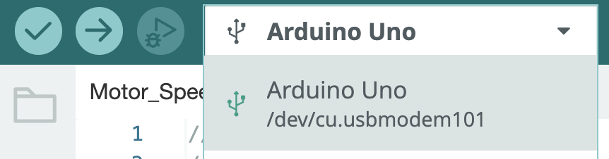
Lastly, make sure to test the program once everything is confirmed in the right locations
1
Connect the USB cord to the location shown in the image to a free USB slot on your computer.
In Arduino IDE make sure the entire program is complete and make sure the computer detects the Arduino Uno and press Upload [→]. This flashes the board loading the program into solid-state memory. After this you no longer need the USB and can power the board independently.
2
2
1

